Slide 1
Connect-Four
Game
Dolly Jani, Vishal Kommidi, Brandon Wroblewski

Slide 2
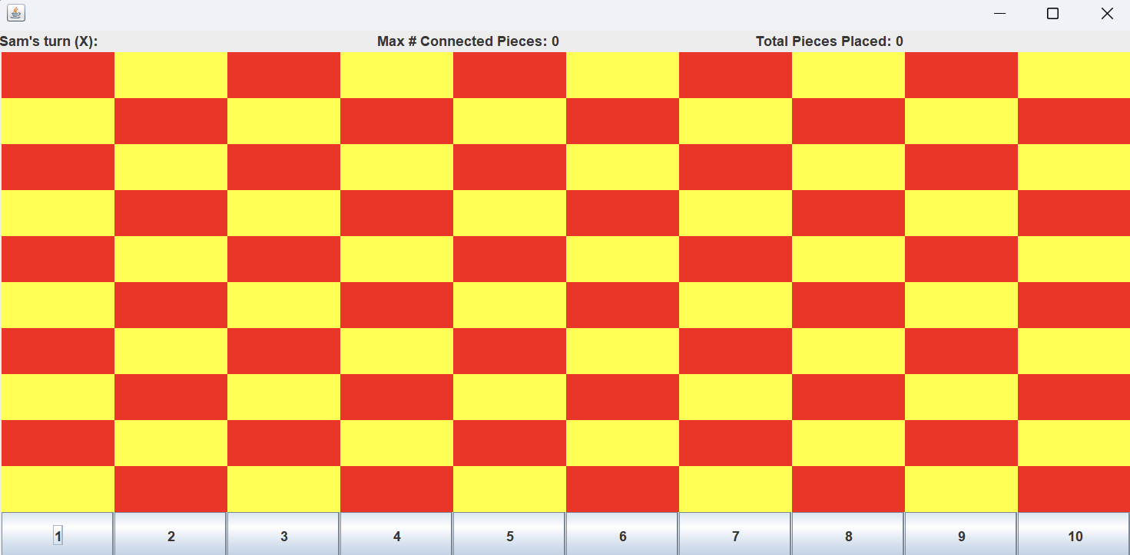
INTRODUCTION
Our game is a interactive GUI program that replicates a connect four game with a modifiable win condition!
Our game has a target audience of kids due to the game being both entertaining and simple!
Notes:
l

Slide 3
DESIGN
CONNECT FOUR:
-ConnectFourGUI: Creates a GUI of a modified connect four game based off of a win condition decided by the user and their name inputs. The game is able to update for each play and automatically switches users, when a player wins the game ends.
-UserInputDialogue: collects user input to set up game. Prompts the user to enter player names, and number of pieces required to win.
-EndScreen: this is end screen GUI display at end of game, showing winner & no. of wins for each user. They can start a new game with same name by clicking “Replay”
- userStats: store and updates user statistics. Tracks the number of pieces placed by each player and calculate no. of maximum number of consecutive pieces they achieved.
Link to UML Diagram

Slide 4
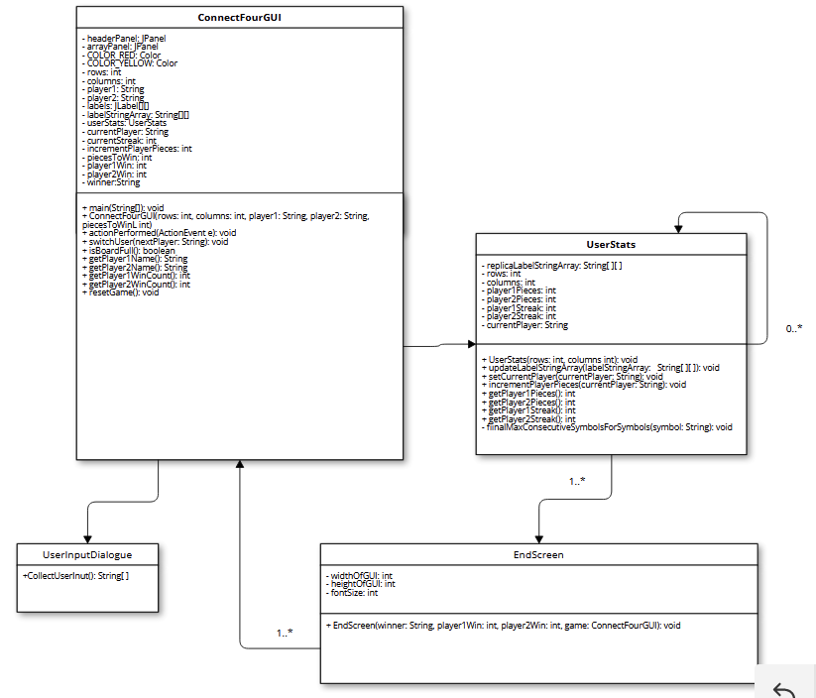

Slide 5
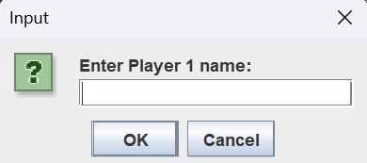
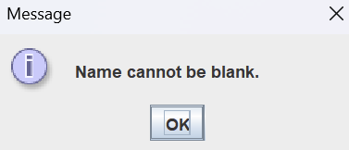
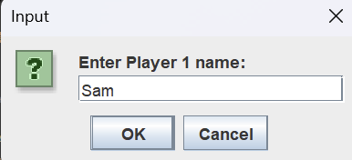
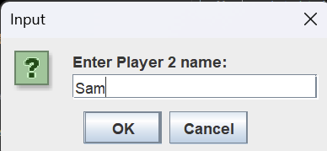
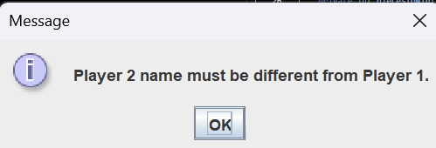
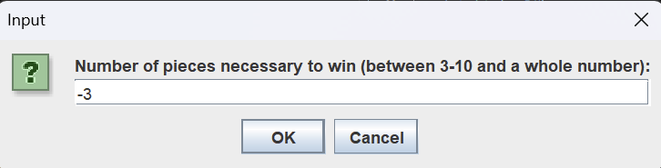
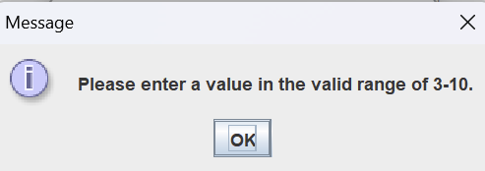
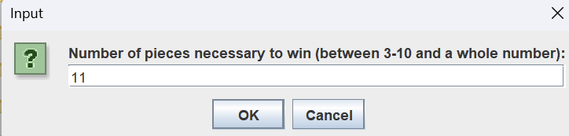
How The Program Runs
1) User is prompted to enter a name into a GUI, if they fail to give a valid name then it will reprompt them (Invalid names would be if user 2 tries using same name as user 1 or gives a blank name)
2) Next it prompts the user for a int, if user fails to give a valid int in a range it will reprompt them

Slide 6
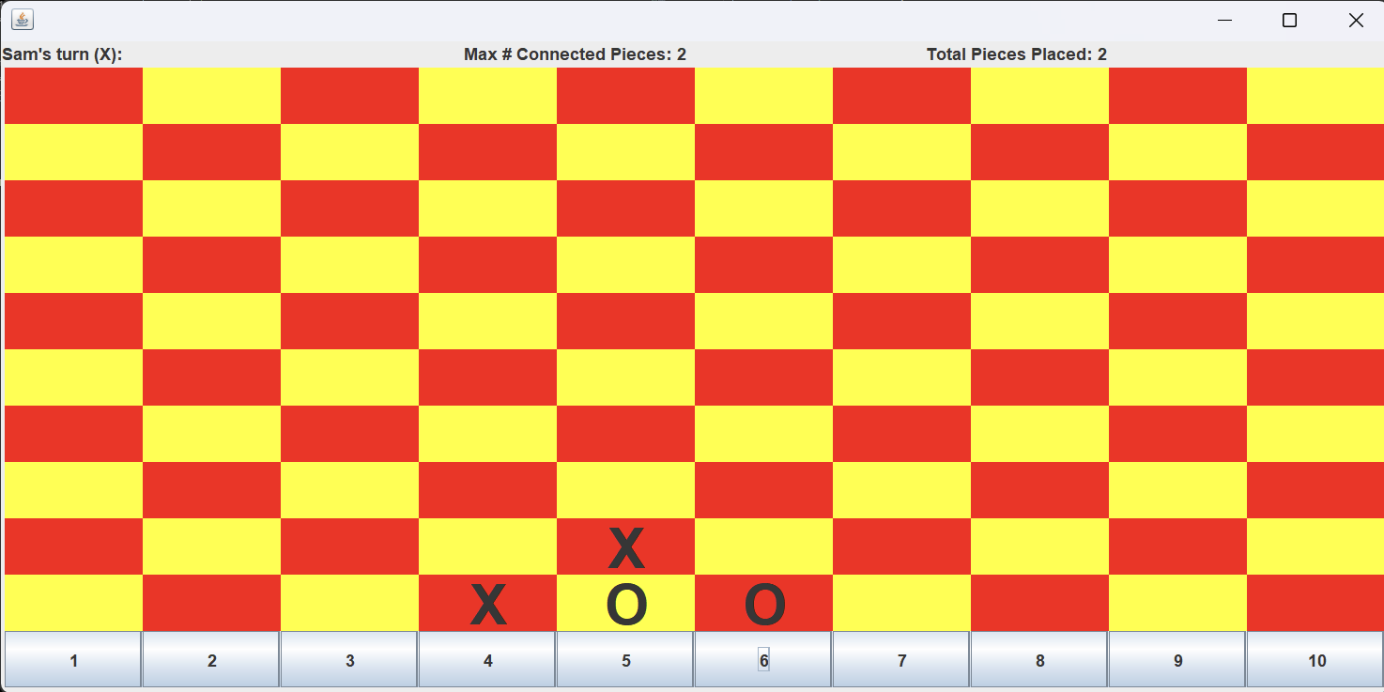
How The Program Runs
3) a GUI pops up of a checkered board which will have lengths double the int value the user gave as in input for a win condition. The top displays how many moves the player placed, the maximum amount they have connected on the board, and who’s turn it is. Each time the user clicks a button it automatically switches to the other user and updates the game board to match the column selected.

Slide 7
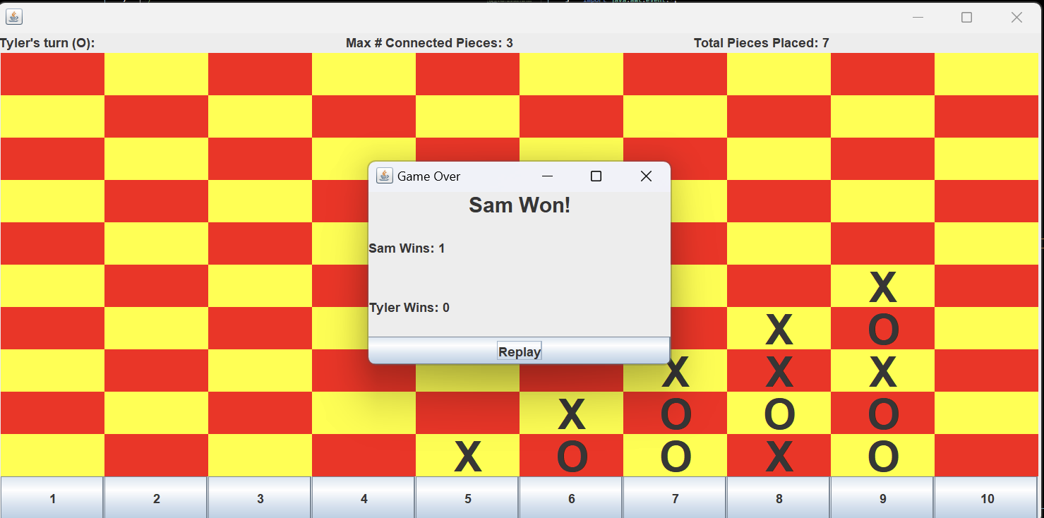
How The Program Runs
4) When a user wins the game it will display a GUI that shows who won (full board if board is full), and total wins of each player, if user clicks replay it will clear the board and restart the game!

Slide 8
LESSONS LEARNED
Continue to create system tests in order to test end-to-end as there are so many possibilities
There is always room for improvement in aspects of implementation because there was increased complexity with the different classes that were involved
Put an increased emphasis on the flowchart/ UML diagram as it simplifies implementation later on
Think of how the classes will work when designing to avoid repetition code between classes

Slide 9
THANK YOU!

